Slide 1

How to Apply for a Visa to Brazil

Slide 2

Visa to Brazil
Official Guide – Brazilian Government
https://www.gov.br/pt-br/servicos/obter-visto-para-viajar-ao-brasil
Foreigners must submit the visa application form duly completed, a valid travel document, proof of payment of consular fees, International Certificate of Immunization (when necessary), and other specific documents for the type of visa requested.

Slide 3

Who Needs a Tourist Visa?
Requirements depend on nationality.
Some travelers are visa-exempt.
We will provide the official list of countries and regions worldwide.

Slide 4
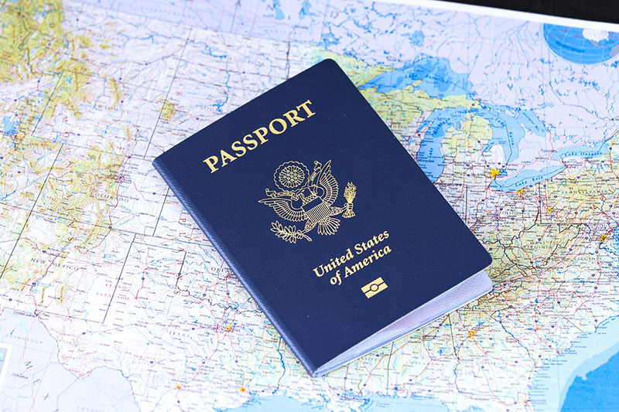
How to Apply
1. Access the official gov.br visa service
2. Complete the online application
3. Print and sign the receipt
4. Gather required documents
5. Submit at the Brazilian Consulate

Slide 5
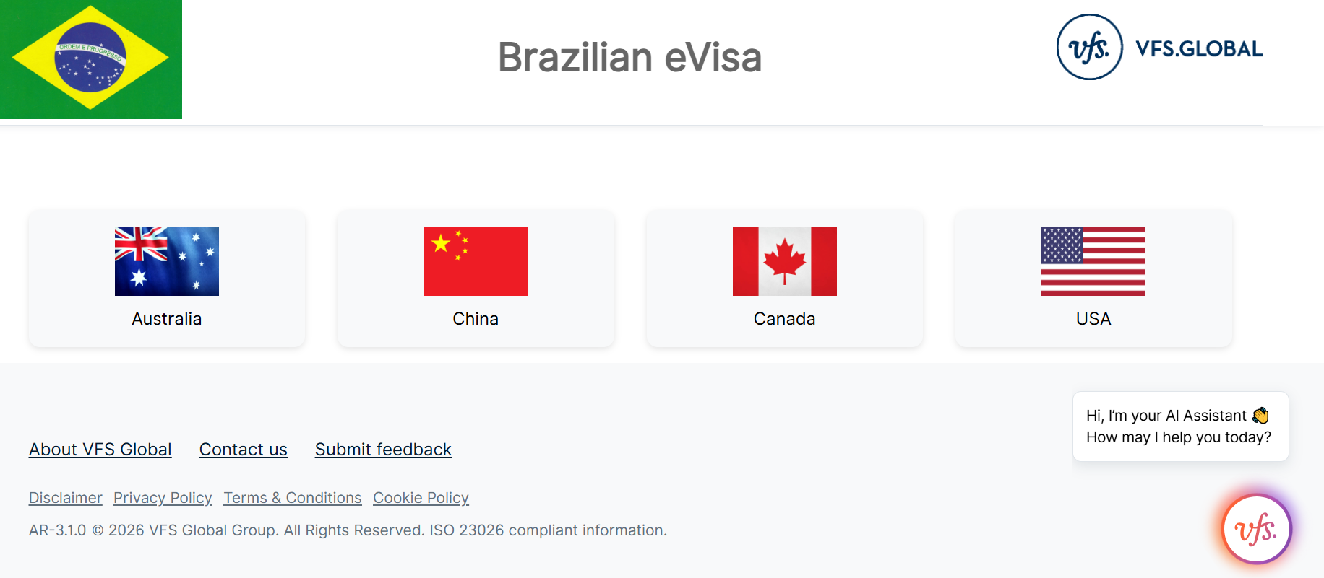
Brazil's eVisa
Citizens from the United States, Canada and Australia can request your visa online at https://brazil.vfsevisa.com/ .
Chinese citizens staying for more than 30 days will need an e-visa.
All the processes will be done electronically, and there will be no need to visit the Consulate.

Slide 6
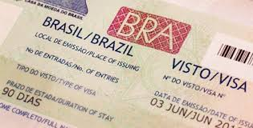
Processing Time & Fees
Fees vary depending on the consulate.
Processing time depends on the consular office.

Slide 7
Important Notes
Visas cannot be issued inside Brazil.
Visa rules can be updated by the government at any time, so always check the official website: https://www.gov.br/mre/pt-br/assuntos/portal-consular/vistos/quadro-geral-de-regime-de-vistos-para-entrada-de-estrangeiros-no-brasil.
If you have any questions, contact the embassy or the Ministry of Foreign Affairs website.

Slide 8
Contact
Contact the Brazilian Representations abroad to obtain more information about the subject. Full list of the Brazilian Consular Network: https://www.gov.br/mre/pt-br/assuntos/portal-consular/reparticoes-consulares-do-brasil/reparticoes-consulares-do-brasil
The contact of the Immigration Division (DIM), the area responsible for coordinating the issuance of Brazilian visas abroad, is: dim@itamaraty.gov.br

Slide 9


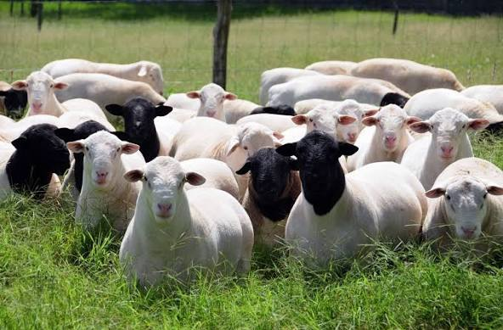
Brazil is waiting for you!

